Slide 1





DIGITAL TALENT SCHOLARSHIP
2019
digitalent.kominfo.go.id

Slide 2
Machine Learning di AWS
Nama pembicara dengan gelar

Slide 3
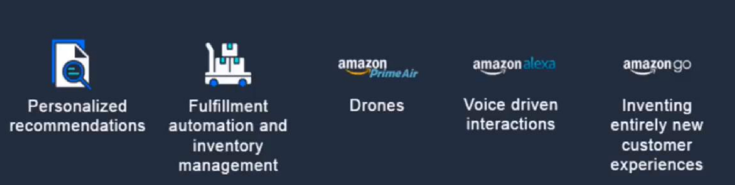
Sejarah Implementasi ML di Aws

Slide 4
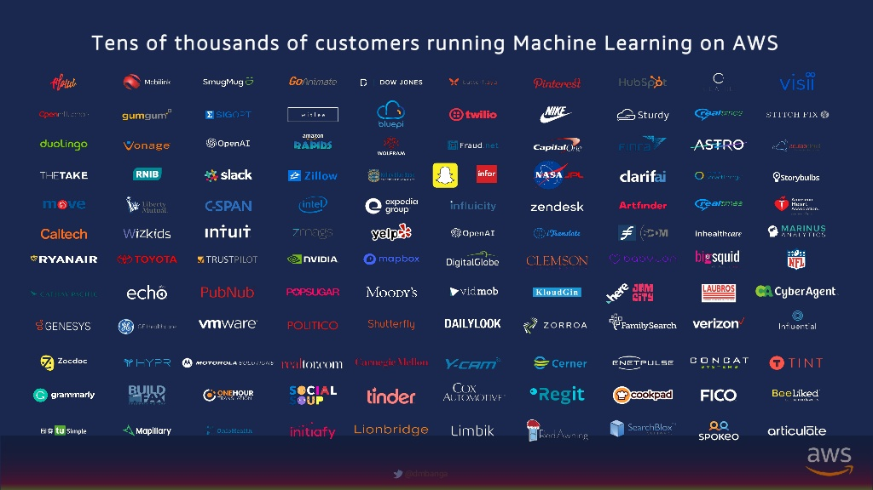
Pengguna Machine Learning di AWS

Slide 5
Contoh Implementasi ML/ Deep Learning
Bagian 2

Slide 6
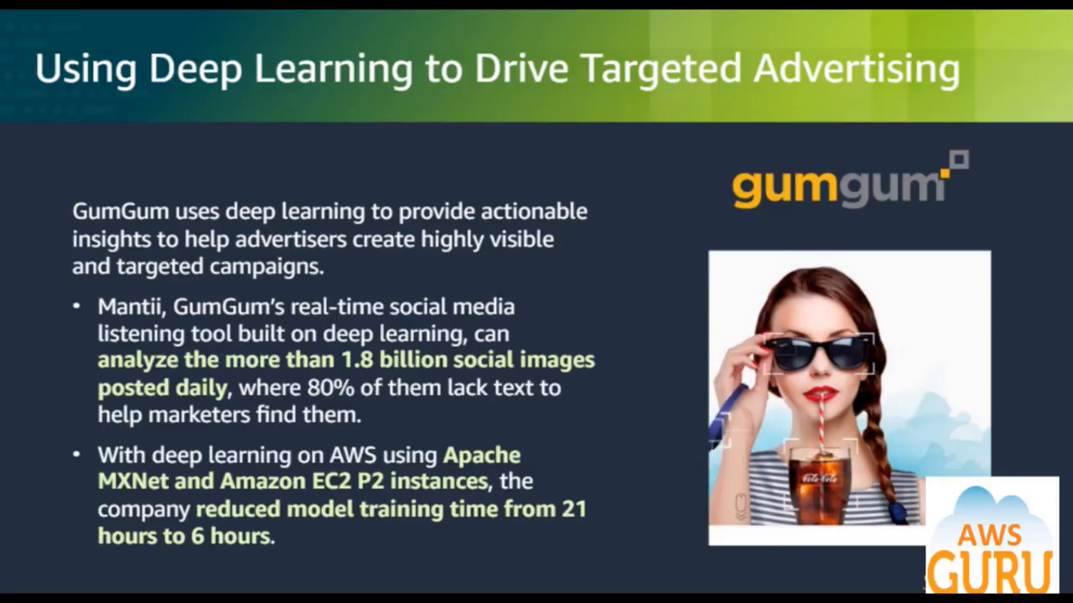

Slide 7
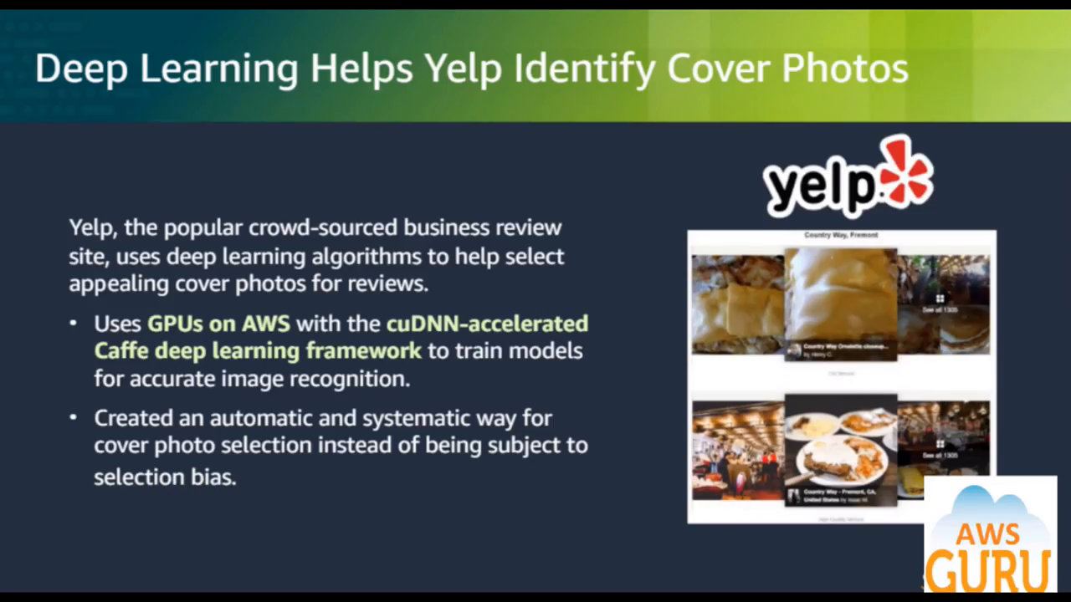

Slide 8
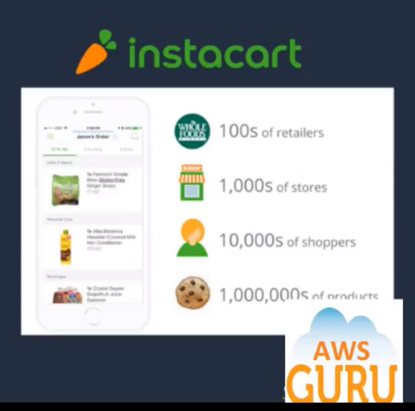
Helping shoppers be efficient using deep learning
Instacart, an internet-based grocery delivery service, uses deep learning to help their thousand of personal shoppers be more efficent.
Trained deep learning models using Keras and TensorFlow to build a scoring generator that helps customers shop based on prior purchases.
Utilized Tesla K80 GPUs on Amazon cloud for siginificant performance and efficiency gains and to reduce customer shopping timer by minutes per trip. At scale, every minute saved will translate into 618 years of shopping time per year.

Slide 9
Tujuan Amazon di Machine Learning
Put machine learning in hands of every developer and data scientist

Slide 10
Amazon Machine Learning Stack
Application Services
Platform Services
Framework & Interfaces

Slide 11
Amazon Machine Learning Stack
Application Services
Platform Services
Framework & Interfaces

Slide 12
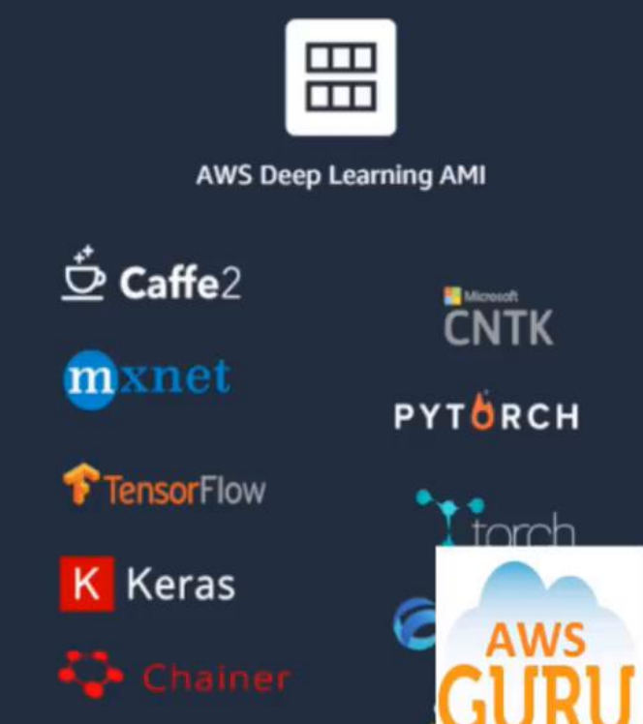
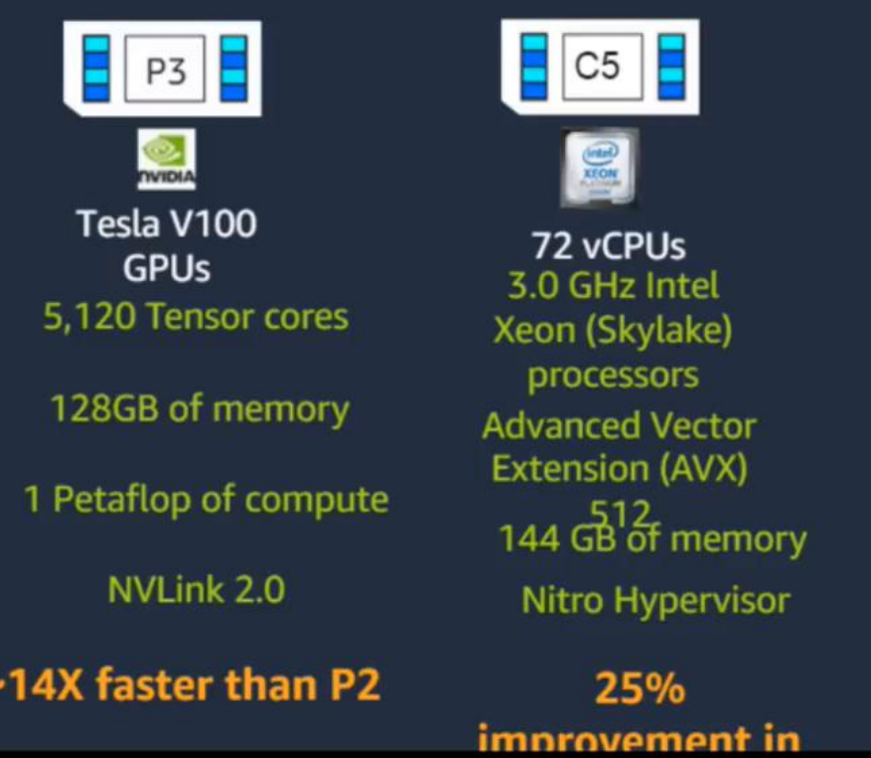
Foundations Layer : Framework Interfaces

Slide 13
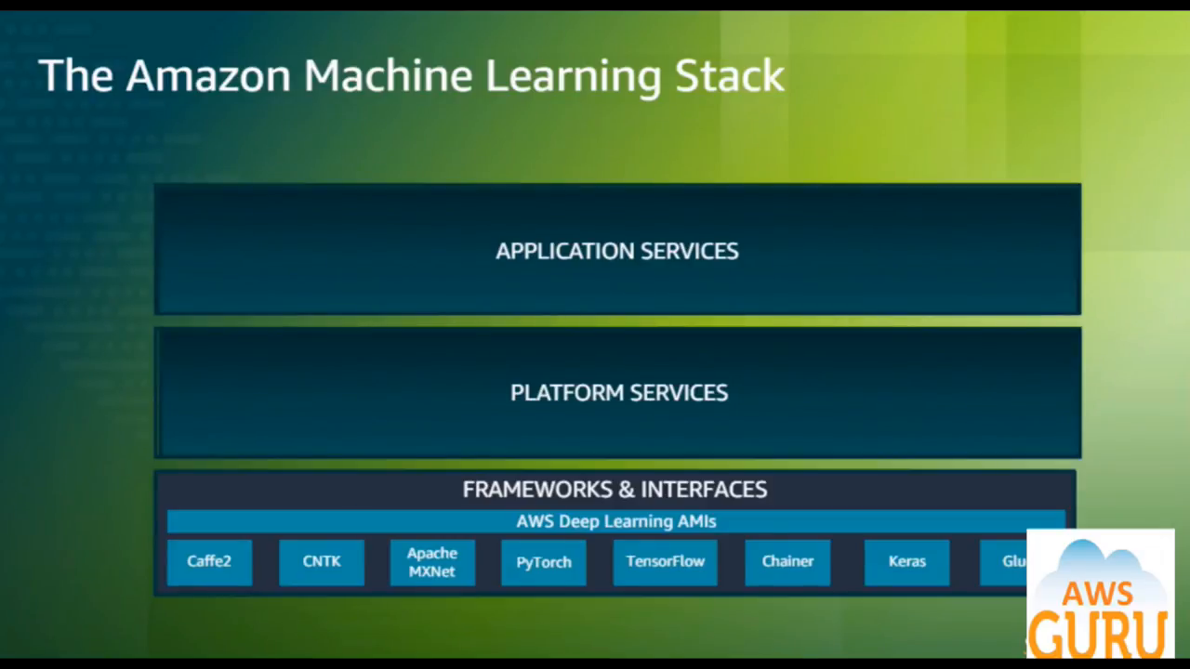

Slide 14
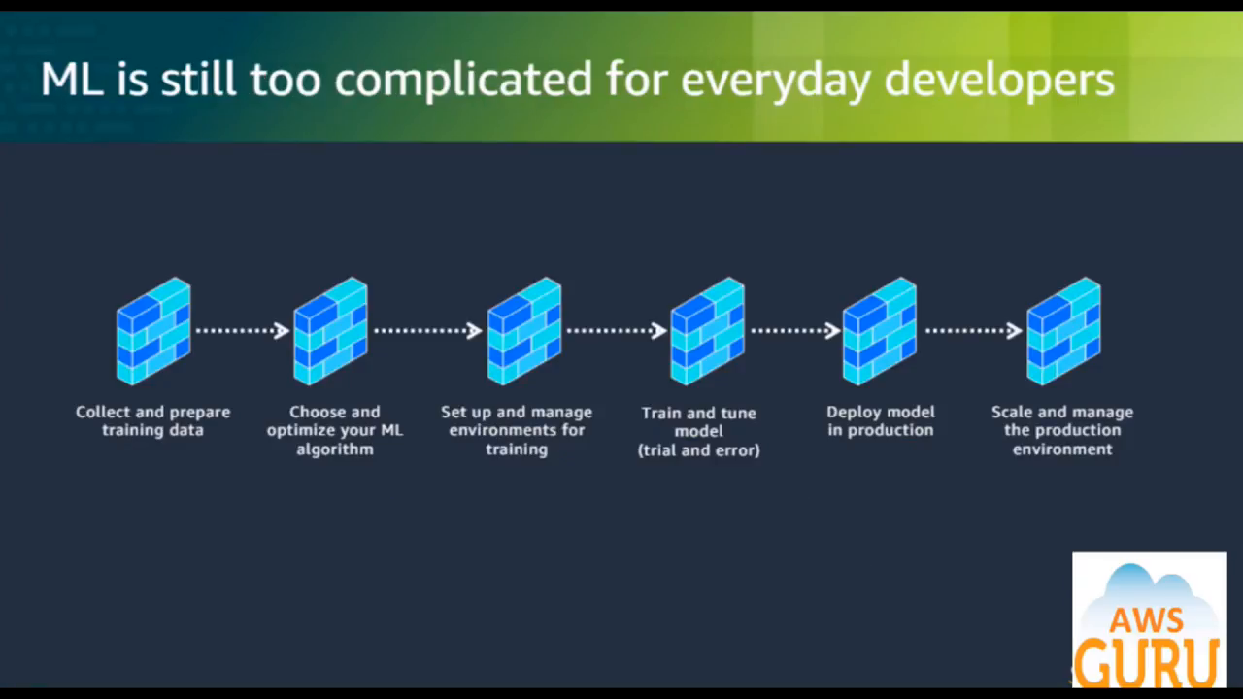

Slide 15
Solusi Amazon untuk Platform ML (Amazon SageMaker)
Bagian 3

Slide 16
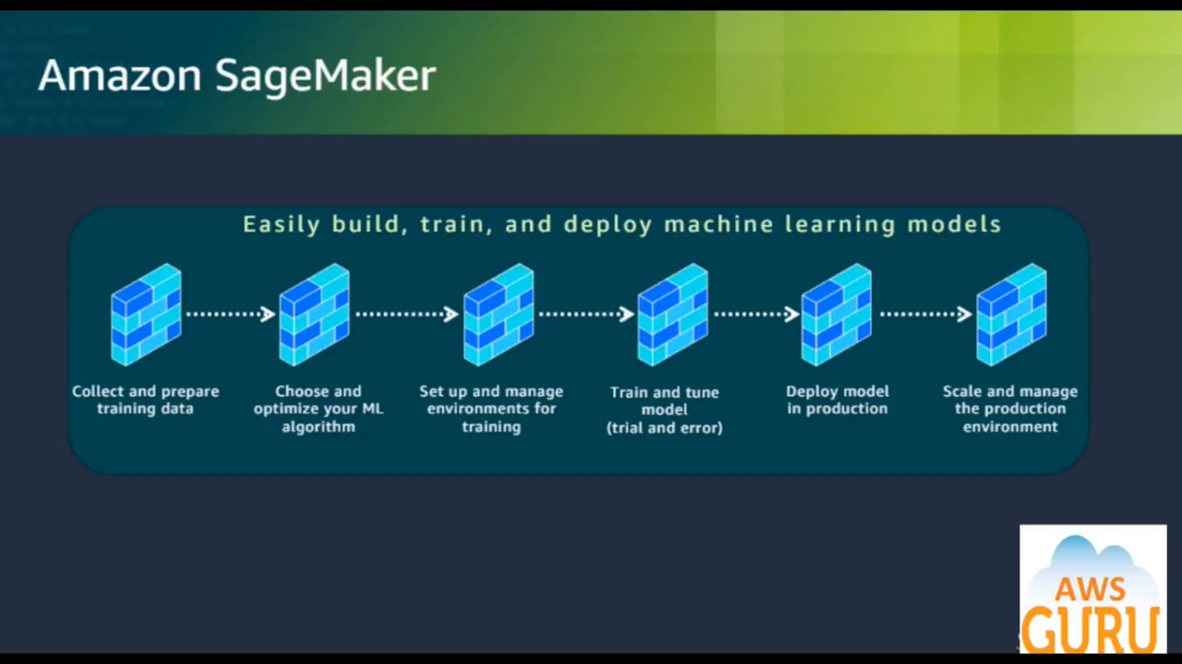

Slide 17
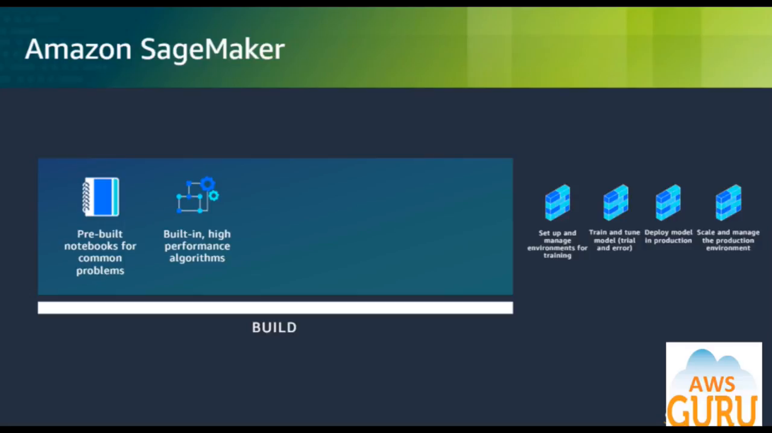

Slide 18
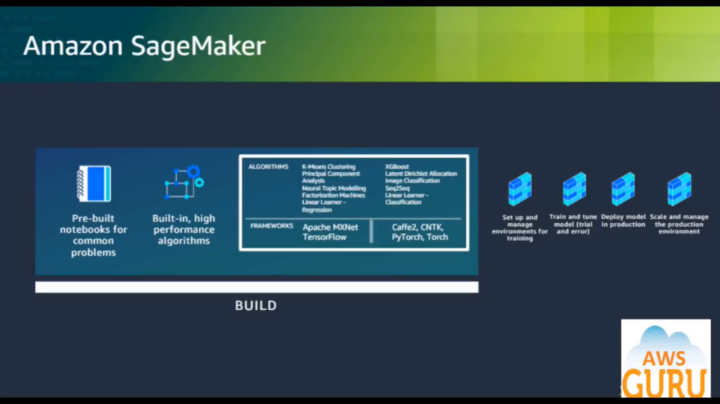

Slide 19
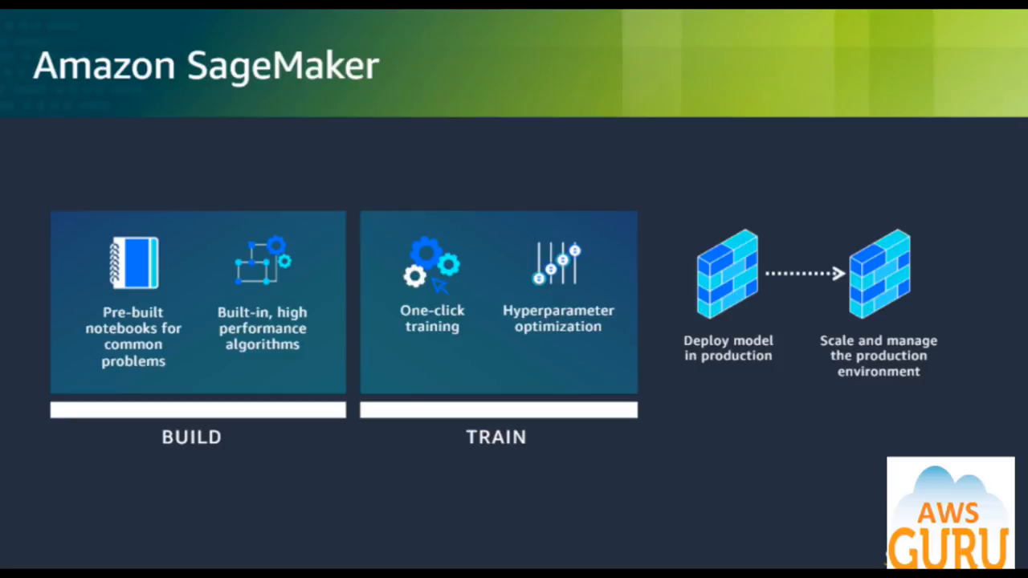

Slide 20
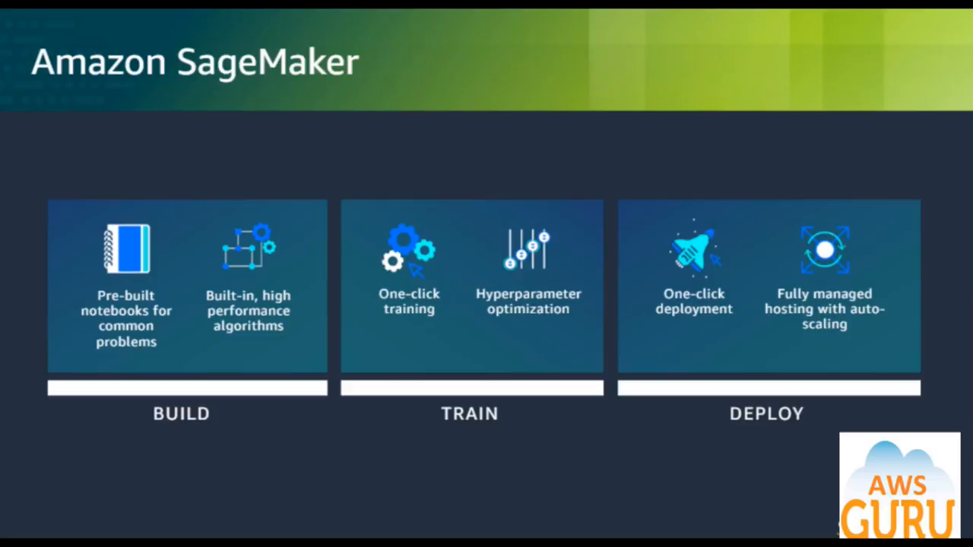

Slide 21
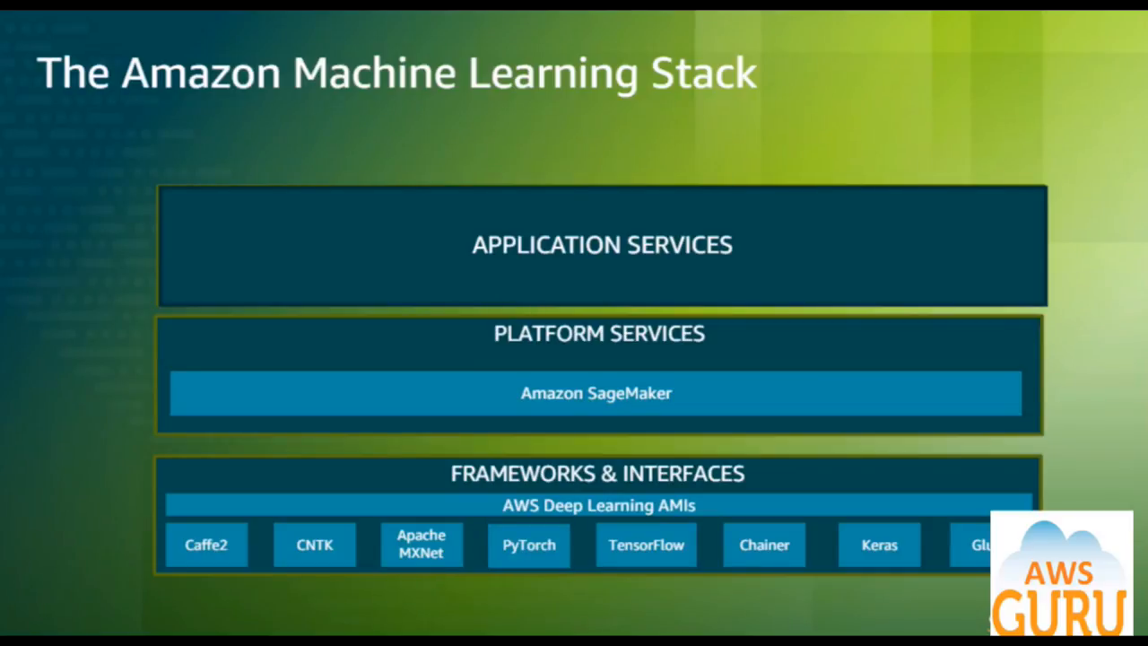

Slide 22
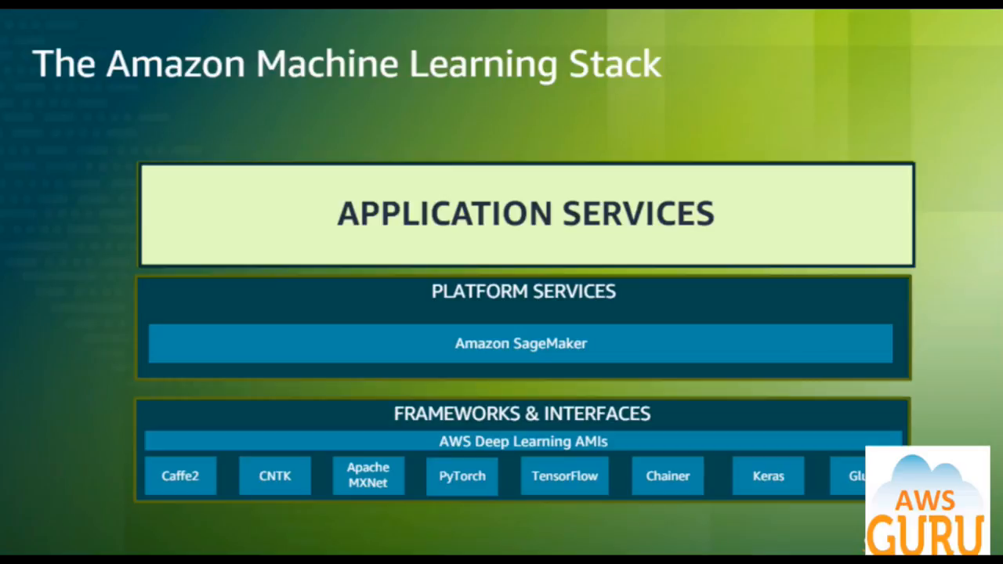

Slide 23
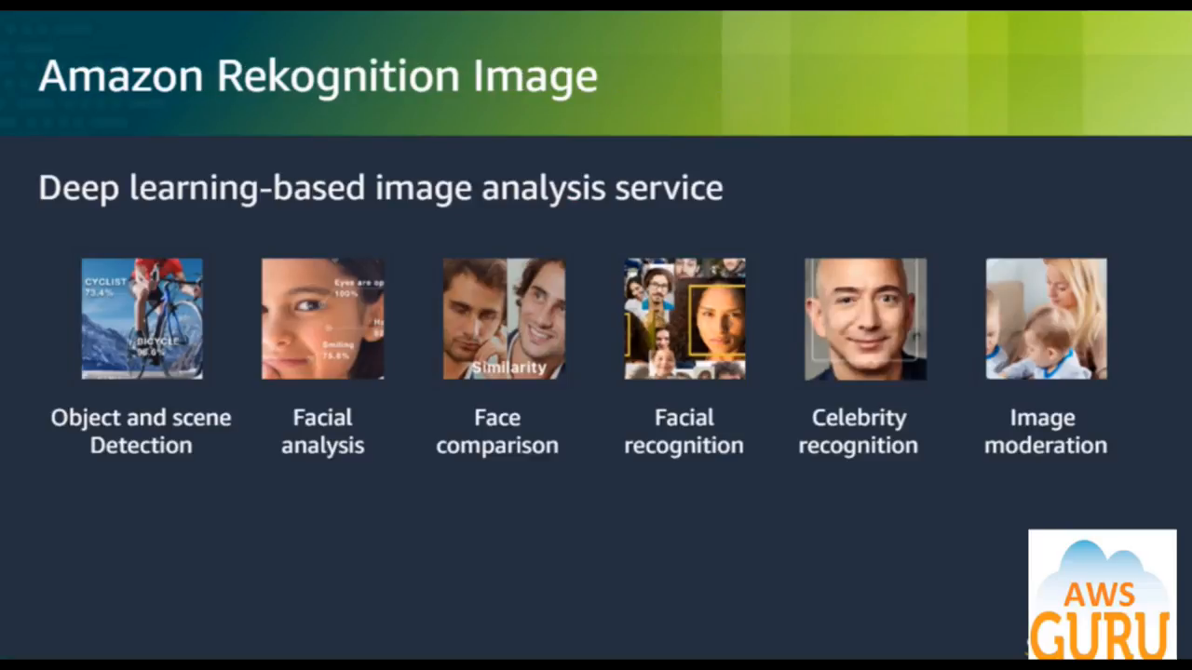

Slide 24
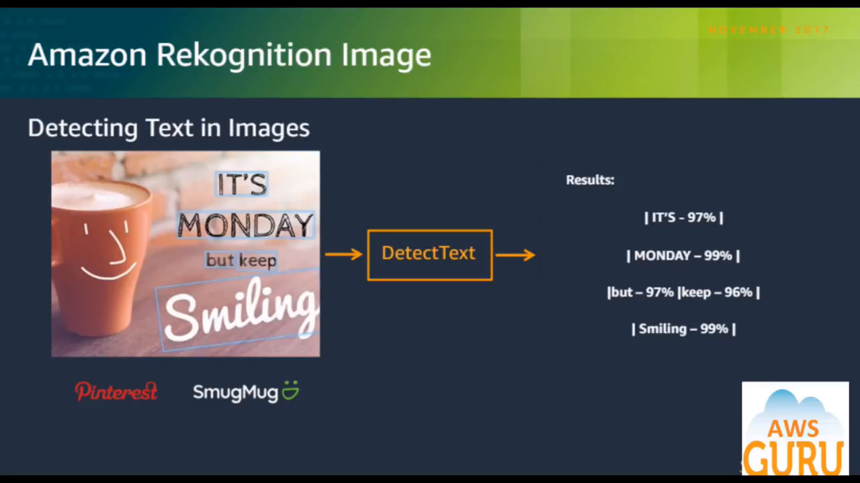

Slide 25
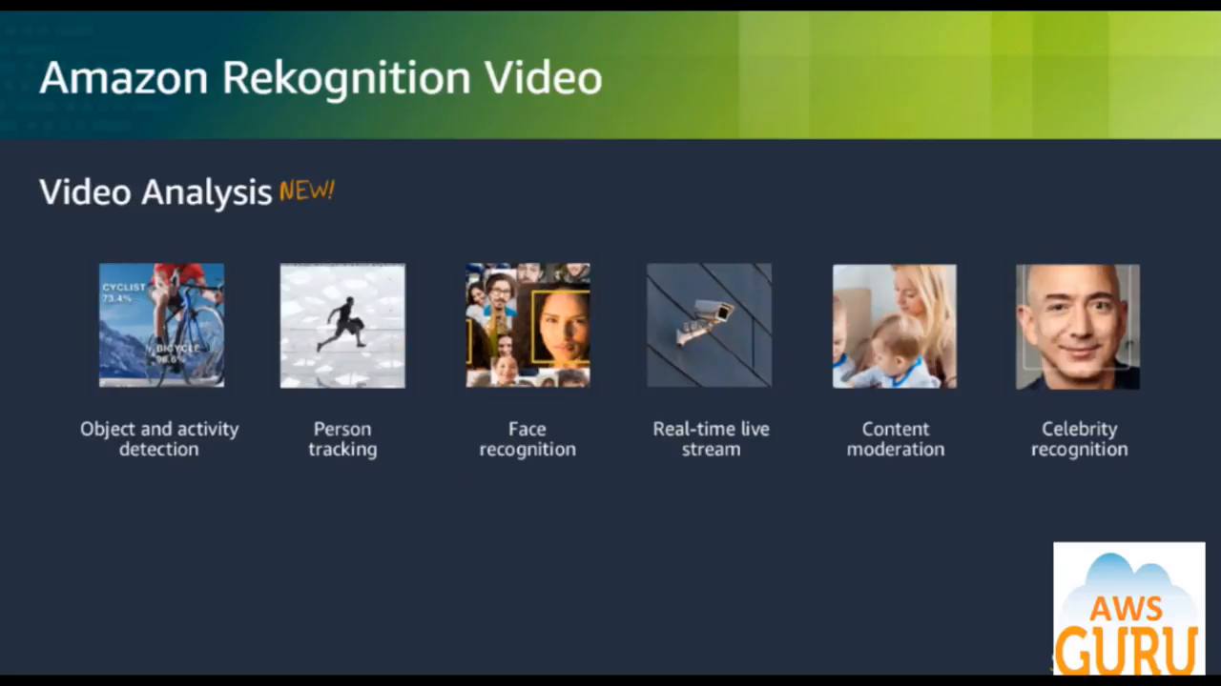

Slide 26

AWS Rekognition

Slide 27
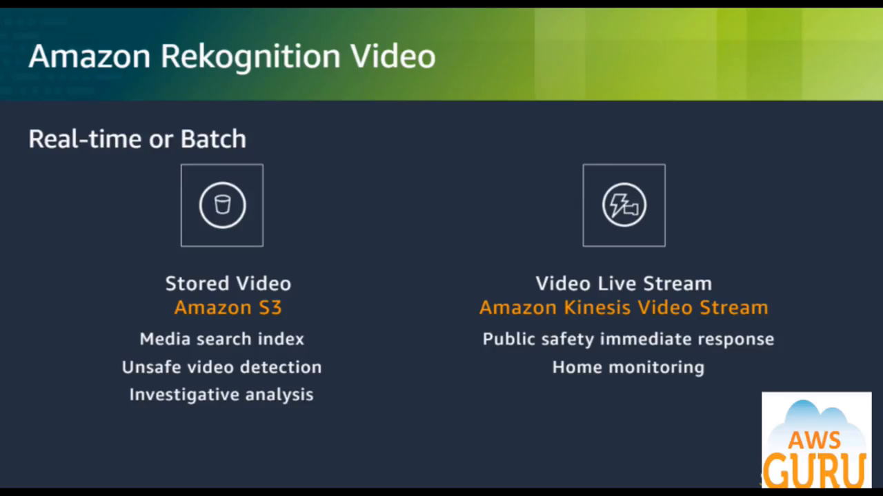

Slide 28
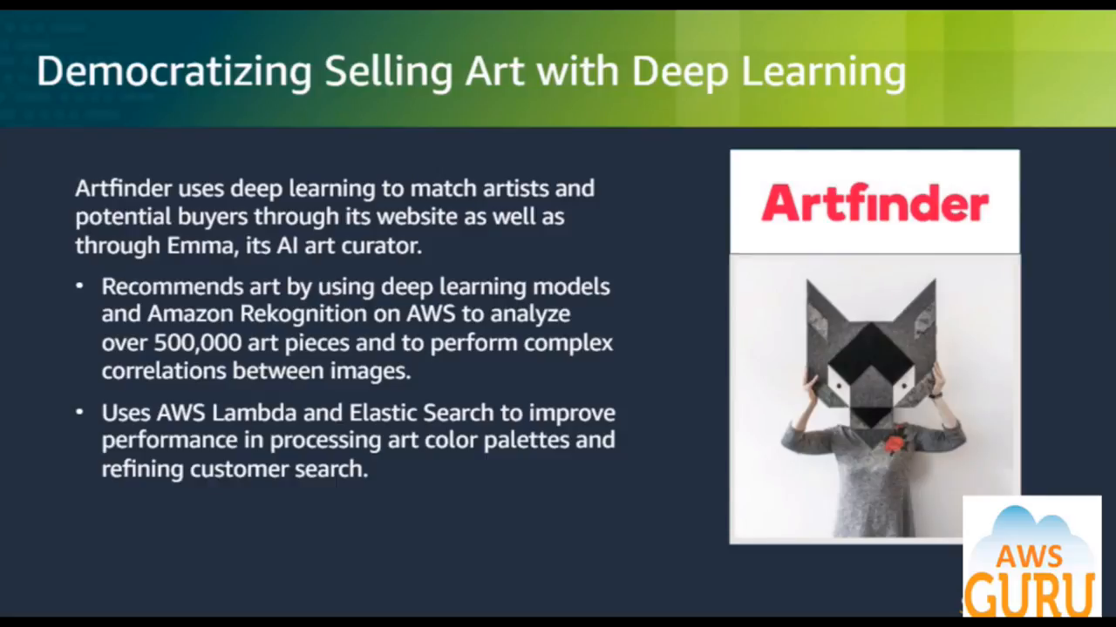
Democratizing selling art with deep learning
Artifinder uses deep learning to match artists and potential buyers through its website as well as through Emma, its AI art curator
Recomendation art by using deep learning models and Amazon Rekognition on AWS to analyze over 500,000 art peces and to perform complex correlations between images.
Uses AWS Lambda and Elastic Search to improve performance in processing art color palettes and refining customer search.

Slide 29
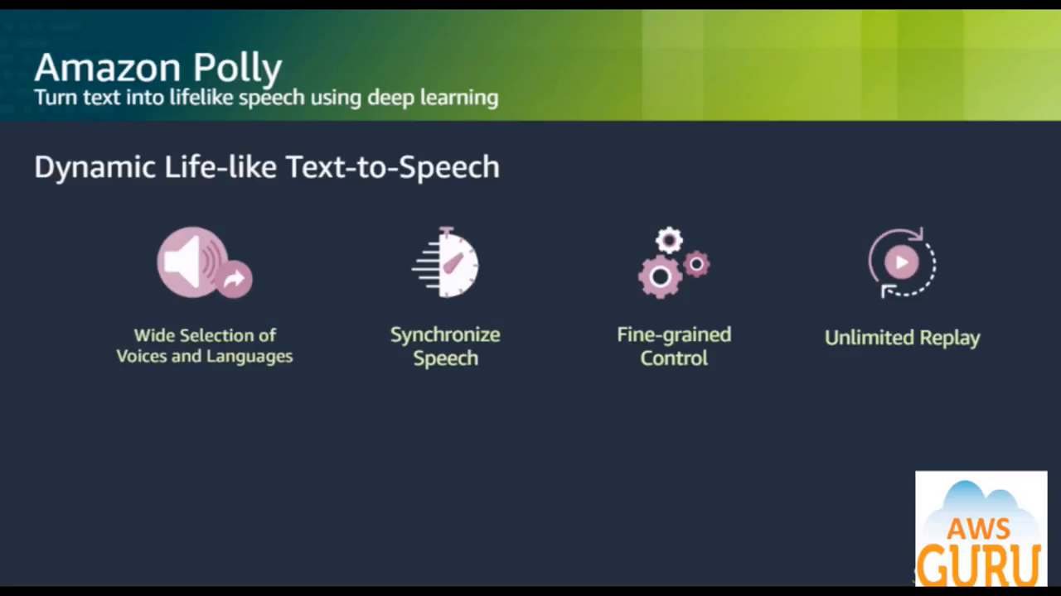

Slide 30
Amazon Polly
Text to speech (TTS) with life-like voice
use cases | key features
centen creation | 52 voices across 25 language
mobile & desktop applications | Lip-Syncing & Text Highlighting
internet of things (IoT) | fine-grained Voice Control
education & E-learning | Custom Vocabularies
Telephony | Available in 14 AWS region
Game development

Slide 31
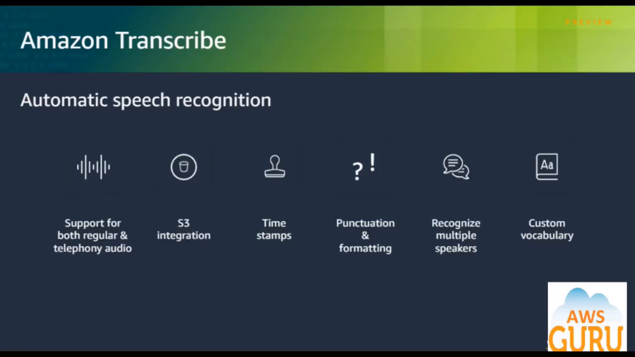

Slide 32
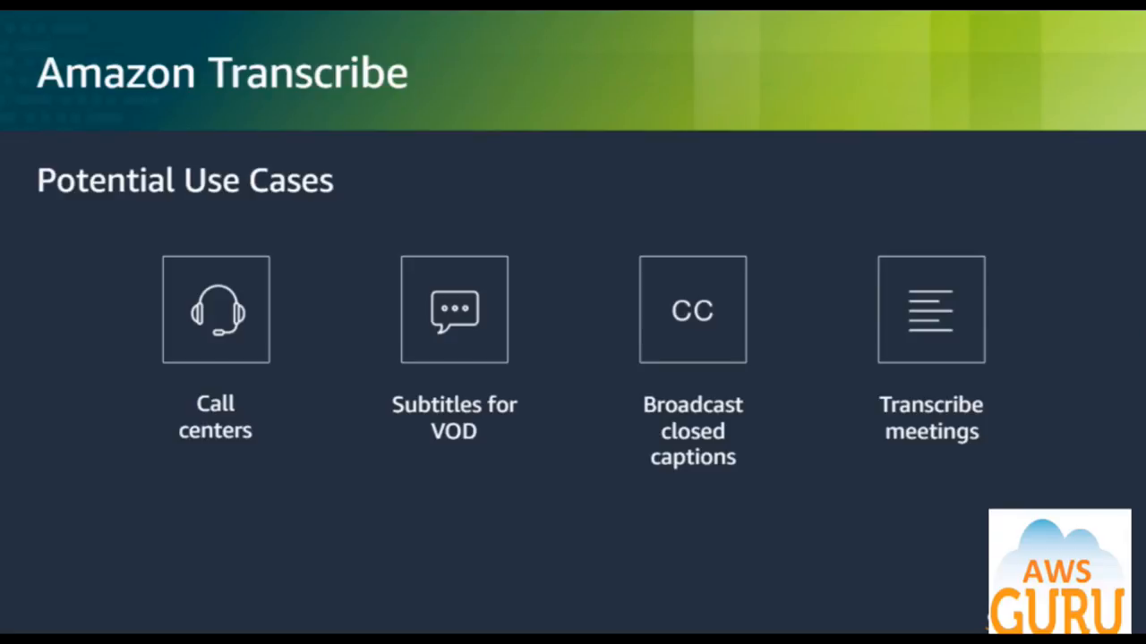

Slide 33
Amazon Transcribe

Slide 34
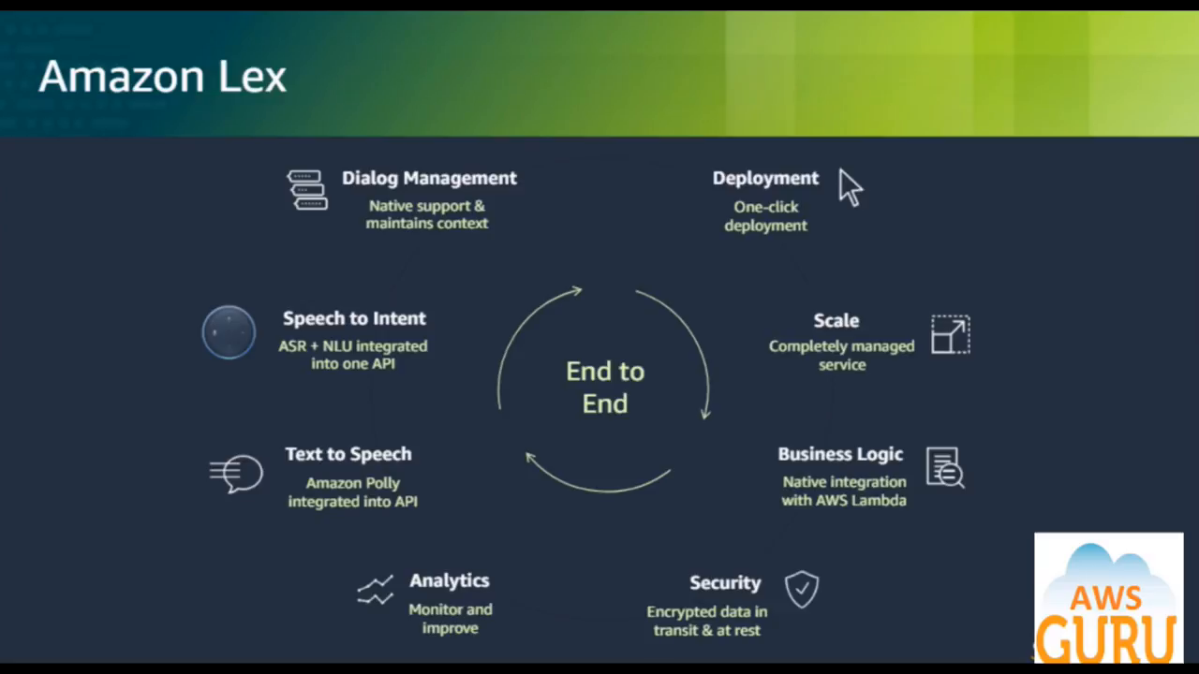

Slide 35
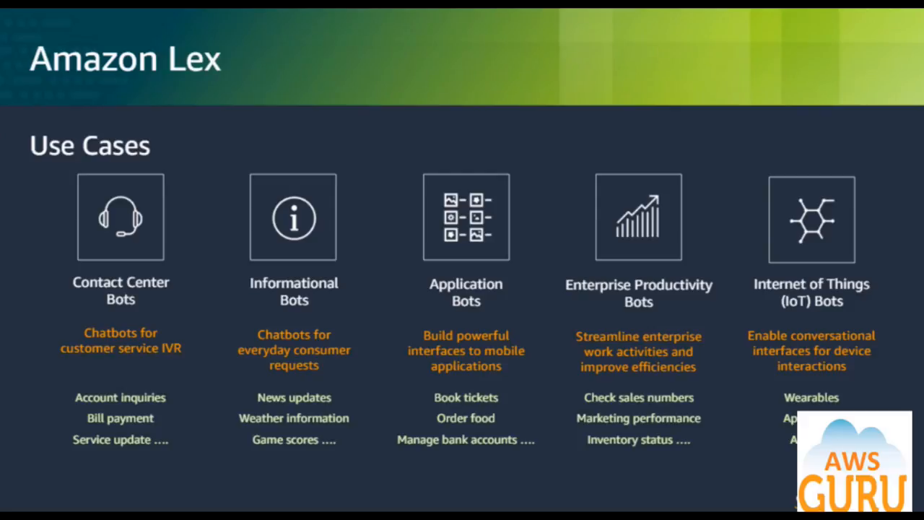

Slide 36
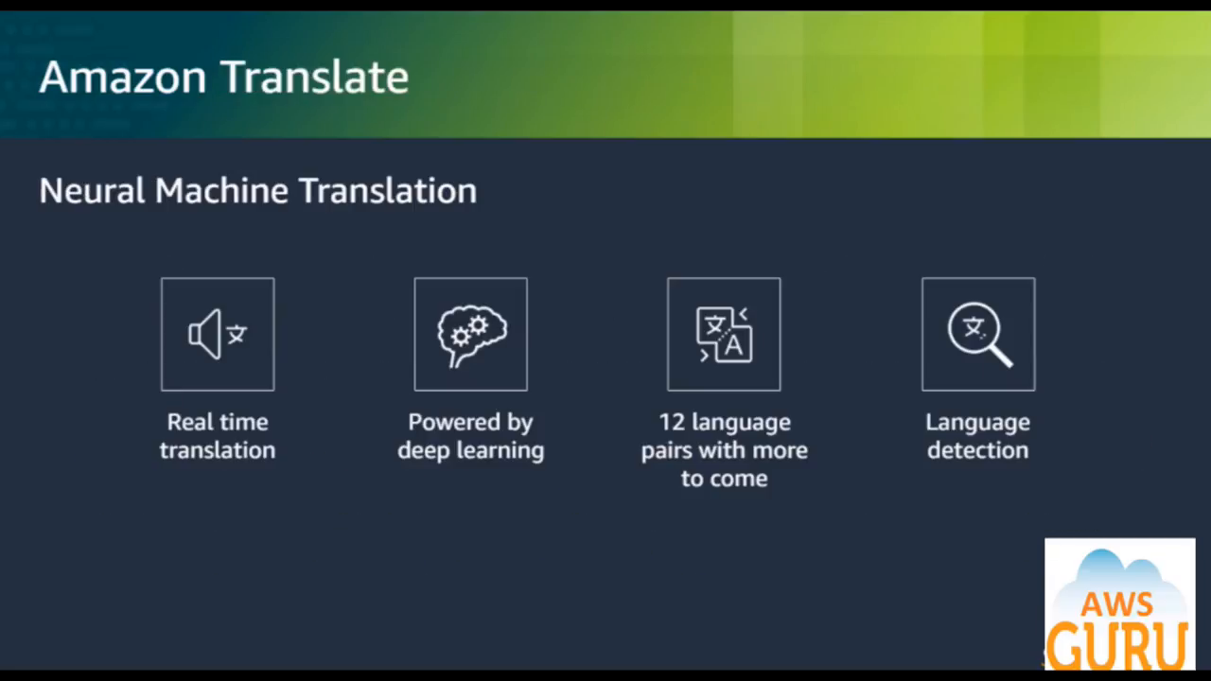

Slide 37
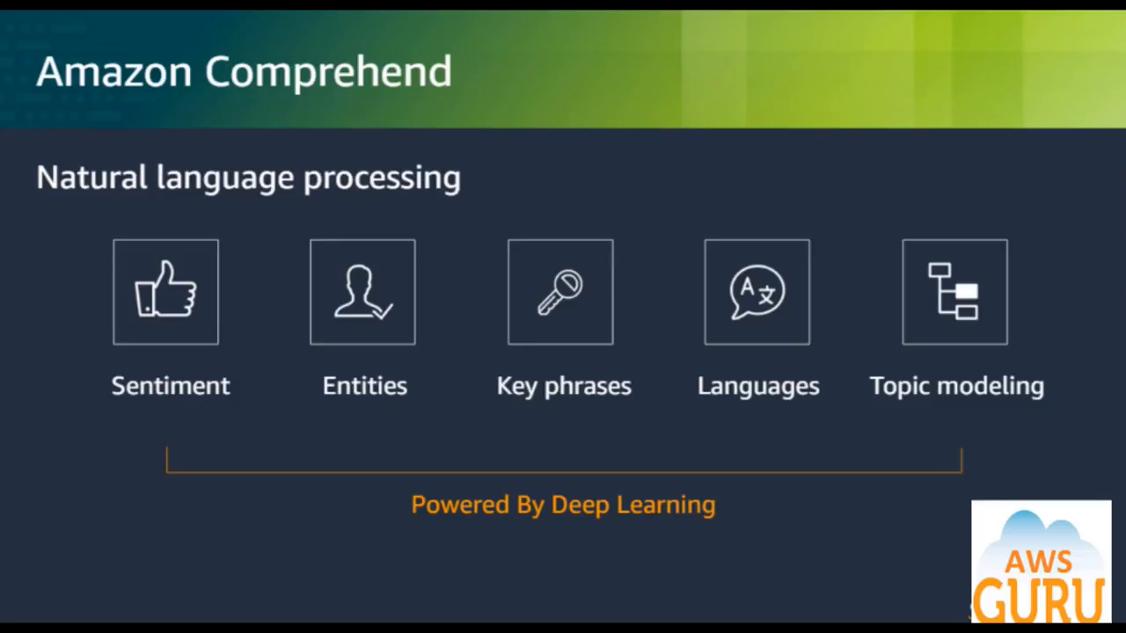

Slide 38
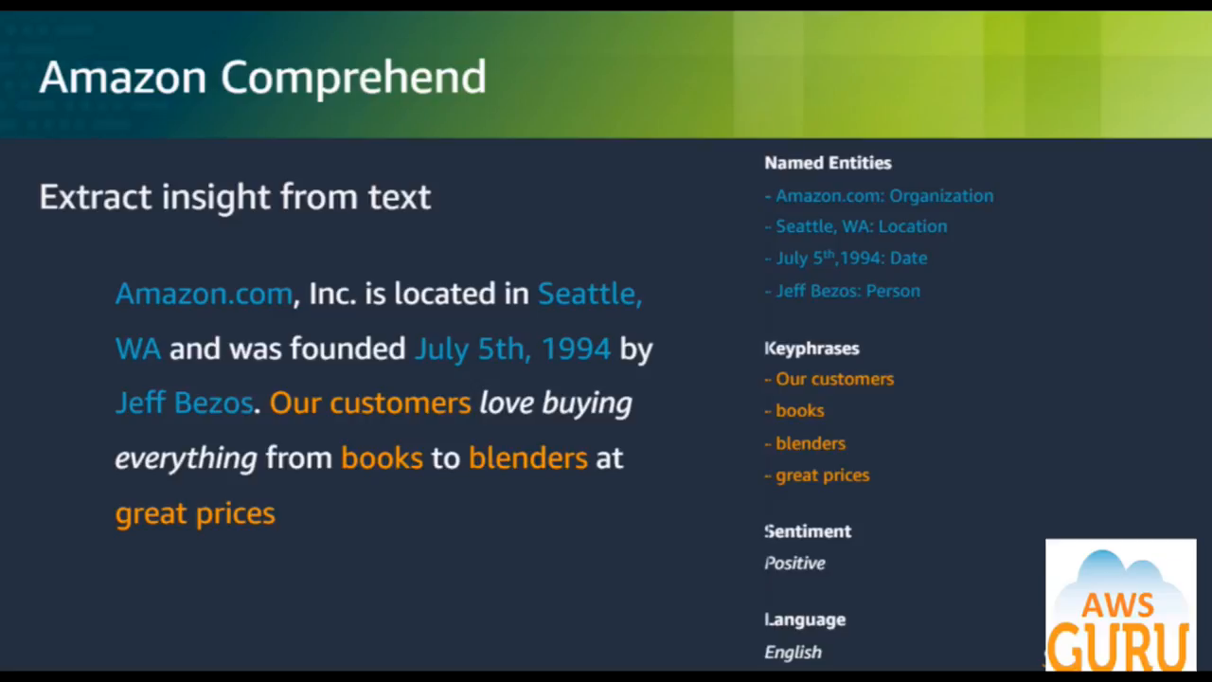

Slide 39
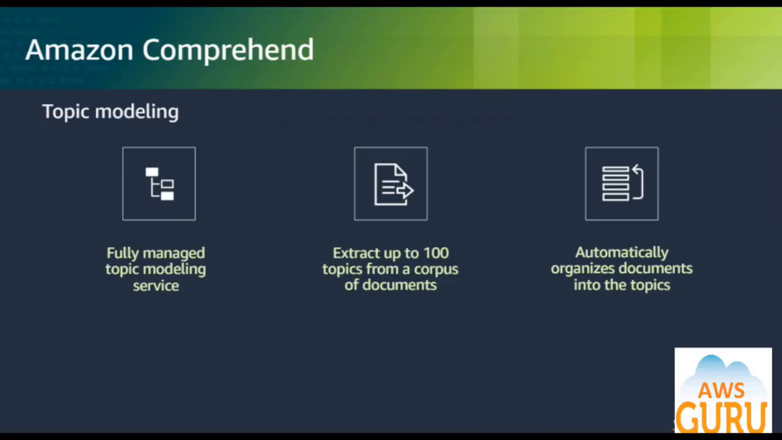

Slide 40
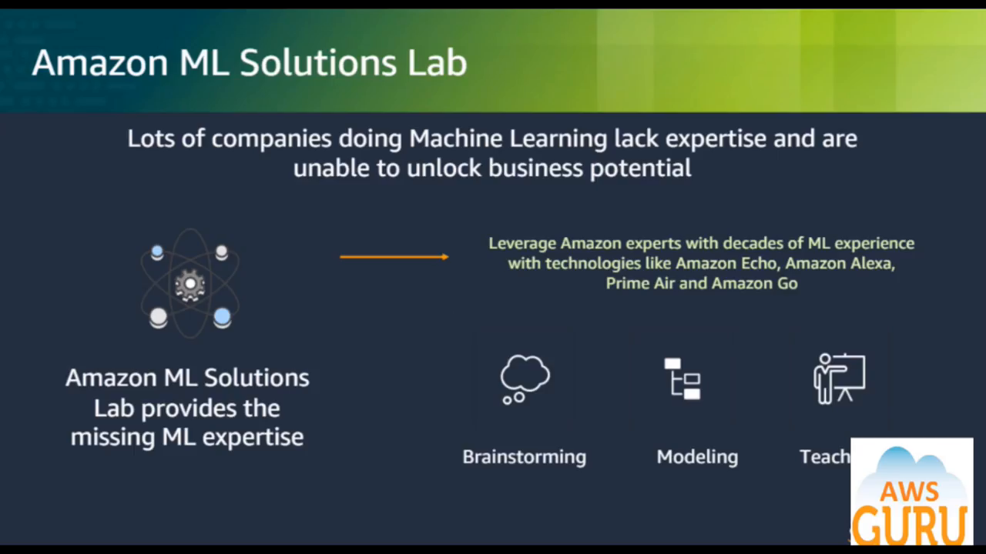

Slide 41
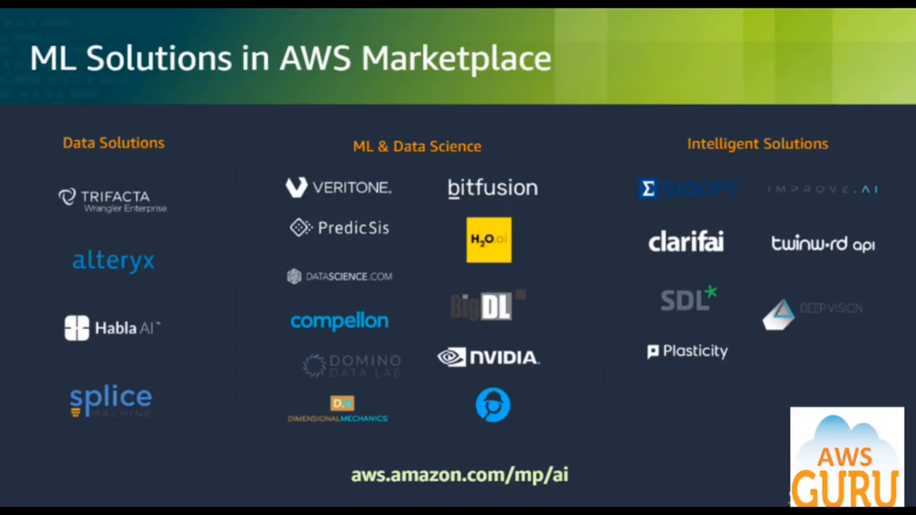

Slide 42





IKUTI KAMI
digitalent.kominfo
digitalent.kominfo
DTS_kominfo
Digital Talent Scholarship 2019
Pusat Pengembangan Profesi dan Sertifikasi
Badan Penelitian dan Pengembangan SDM
Kementerian Komunikasi dan Informatika
Jl. Medan Merdeka Barat No. 9
(Gd. Belakang Lt. 4 - 5)
Jakarta Pusat, 10110
digitalent.kominfo.go.id

